Slide 1

Warehouse Data: Extract,Transform, Load, Visualize
Nishtha Narayan

Slide 2
Agenda
Overview
Technology and Frameworks
Data Analysis
ETL Process
Key Insights
Dashboards

Slide 3
Overview
In this project, I analyzed warehouse data for a leading German company in electrical wholesale distribution. I handled data engineering tasks such as analysis, cleaning, transformation, and loading. Additionally, I served as a data analyst, creating visualizations and dashboards.
This project aims to provide a comprehensive analysis of the data and a streamlined ETL process. It aims to provide data insights in the form of KPIs visualized in a dashboard.

Slide 4
Technologies and Frameworks :
Python : pandas, numpy, pymysql, mysql-connector-python, pandas sqlalchemy
MySQL
Jupyter Notebooks
Tableau
MySQL Workbench

Slide 5
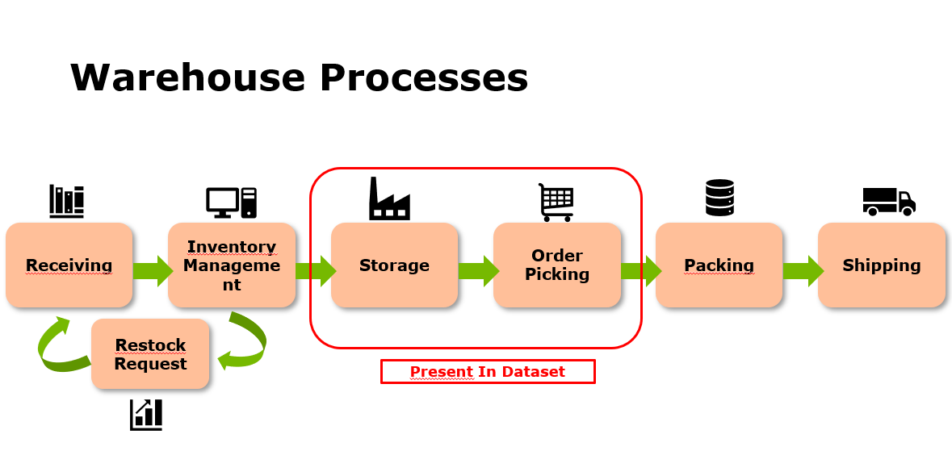

Slide 6
Data Analysis
This project is based on three source datasets; Warehouse_data, Pick_data, and Product_data.
Warehouse_data contains information about the warehouse sections, if it is manual or automatic warehouse.
Product_data contains information about the product_SKUs, which product group they belong to, thier quantity units ( kg, st etc).
Pick data contains information about orders, an order contains how many products, where is this product stored, how many units of this product are picked, in which order, and a timestamp for each pick.

Slide 7
Outlier Detection
Wharehouse Section | QTY Group | Count | # Outliers | % Outliers
SHL | ST | 14,140,653 | 185,636 | 1.31%
 | Mt | 50,730 | 1,700 | 3.35%
 | Se | 20,255 | 361 | 1.78%
 | Ro | 20,097 | 461 | 2.29%
 | Bl | 178,672 | 2,684 | 1.50%
 | Pa | 53,201 | 830 | 1.56%
 | VE | 24,851 | 311 | 1.25%

Slide 8
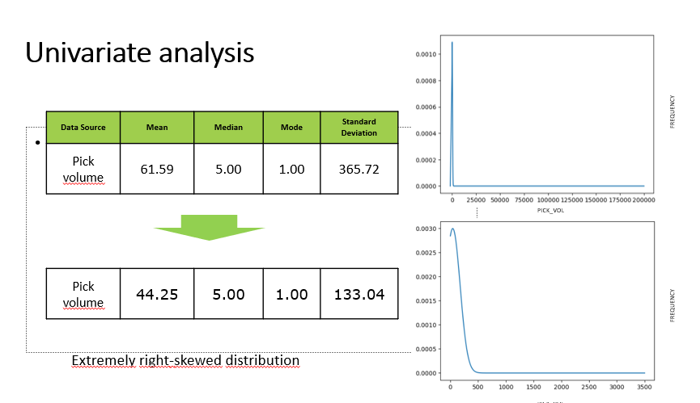

Slide 9
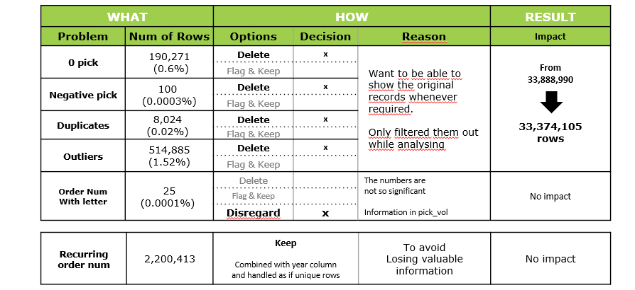
Cleaning and Impact

Slide 10
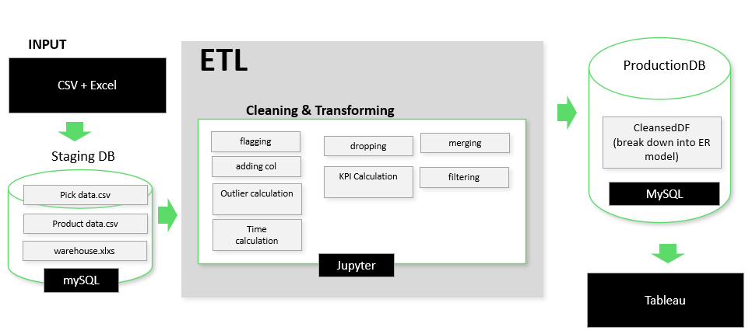
ETL Process

Slide 11
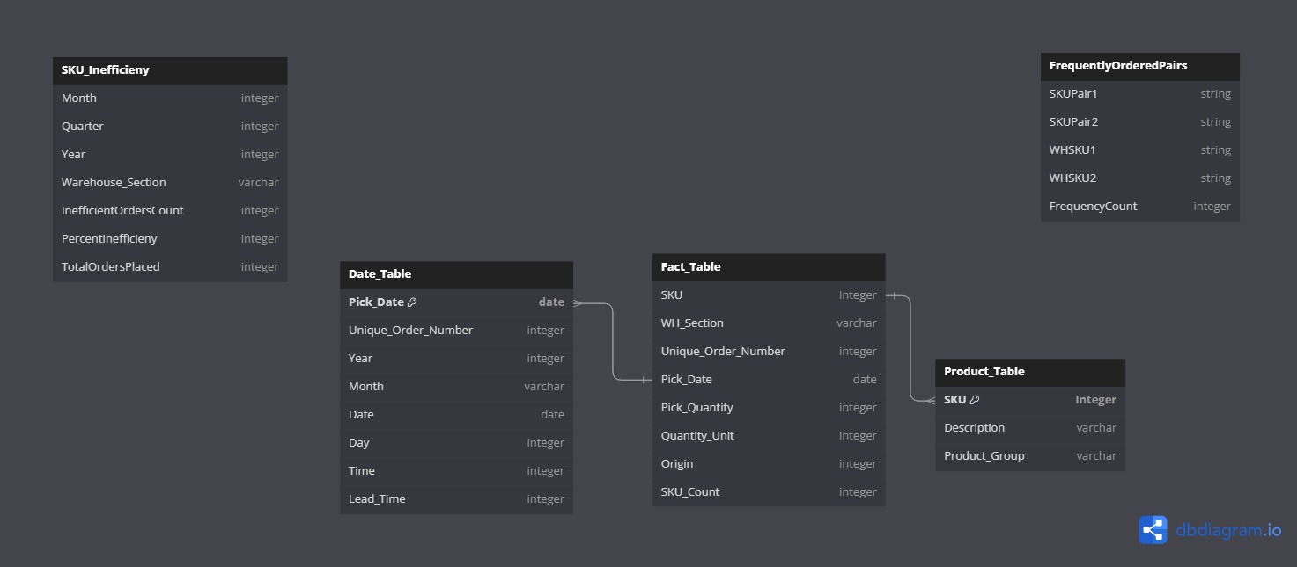
ER Model

Slide 12
Cleaning and Transformation
Cleaning
Transformation
Establishing concise and clear column headers.
Identifying and handling data inconsistencies and outliers.
Handling null and garbage values.
Handling special characters.
Dropping unnecessary columns and records.
Creating Primary keýs to identify each record uniquely.
Establishing Entity Relationship between the datasets and fitting them into a star schema model.
Performing Time series calculations to gain insights from the data.
Calculating lead time.
Establishing the granularity of the data.
Calculating KPIs like SKU Inefficiency, Warehouse performance, product performance, Origin of the order etc

Slide 13
Key Insights

Slide 14
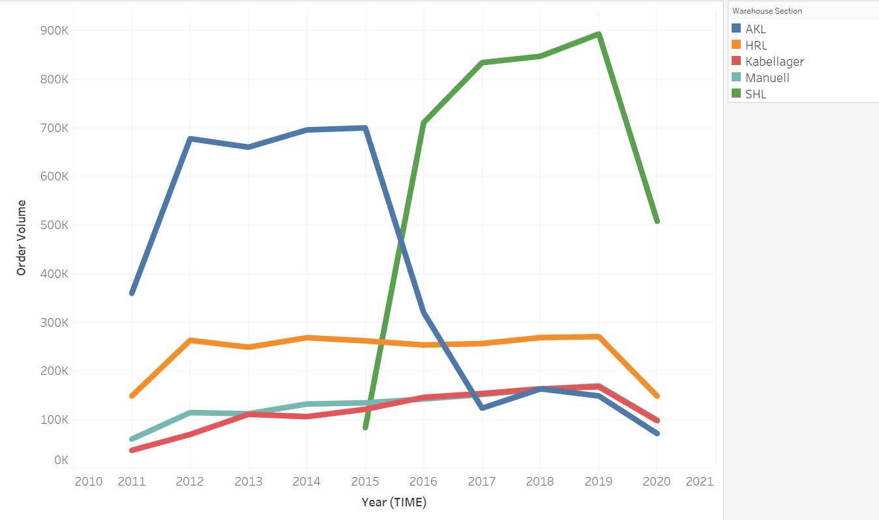
Order Volume per Warehouse
SHL since 2015, they initiated new warehouse (SHL) and it took over AKL, being the most handling WH by 2020.
Significant decrease in all WHs in volume order in 2020.

Slide 15
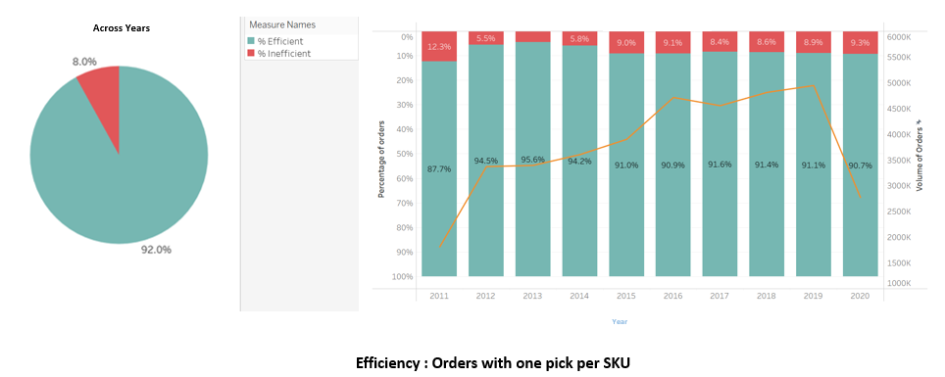
Order Efficiency
Efficiency : Orders with one pick per SKU
Since 2015 the percentage of inefficent orders has increased. Possible correlation with the shift to SHL.
2020 has the second worst inefficiency ratio and second lowest volume

Slide 16
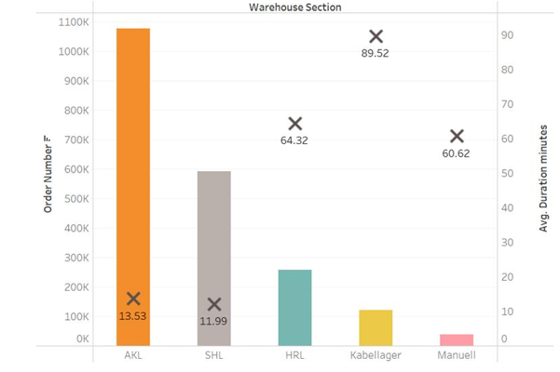
Lead Time Analysis
Kabellager is the worst performing.
SHL had better performance in term of avg lead time.

Slide 17
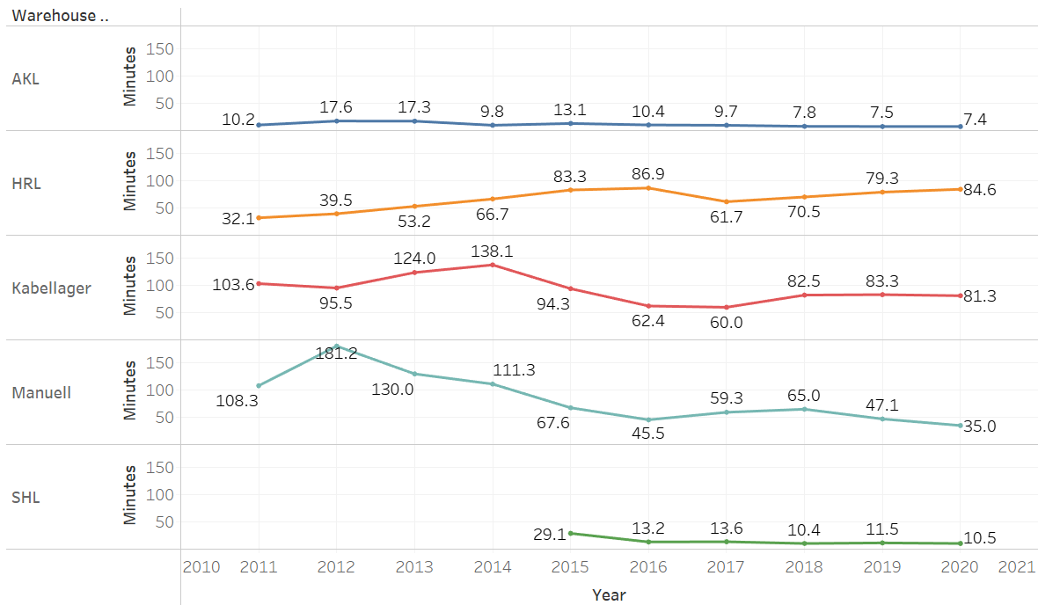
Lead Time per Warehouse
The automatic warehouses AKL and SHL have the fastest completion time

Slide 18
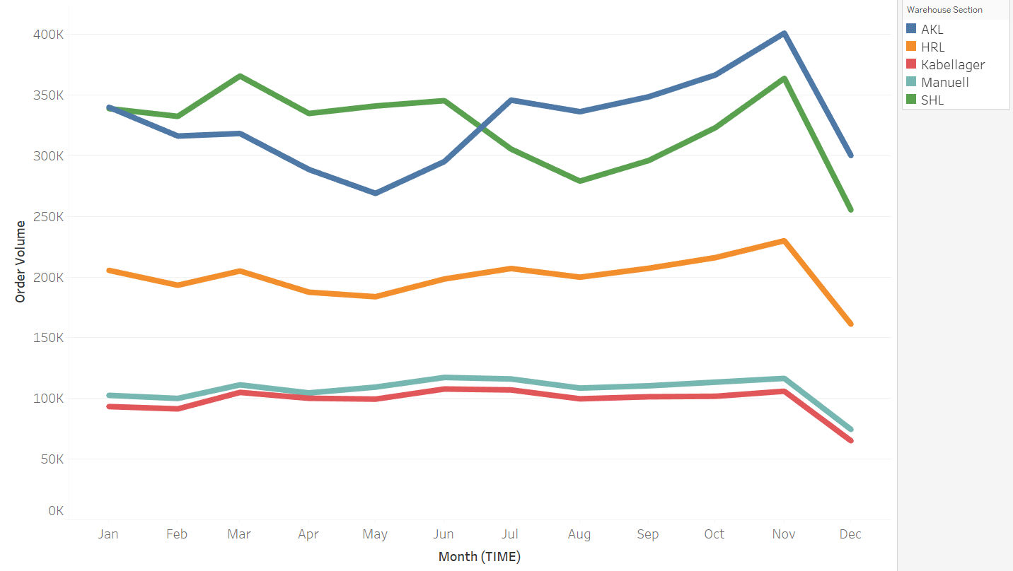
Monthly Order Flow
Biggest Peak in November for all WH
Steep down in December, influenced by the holiday season

Slide 19
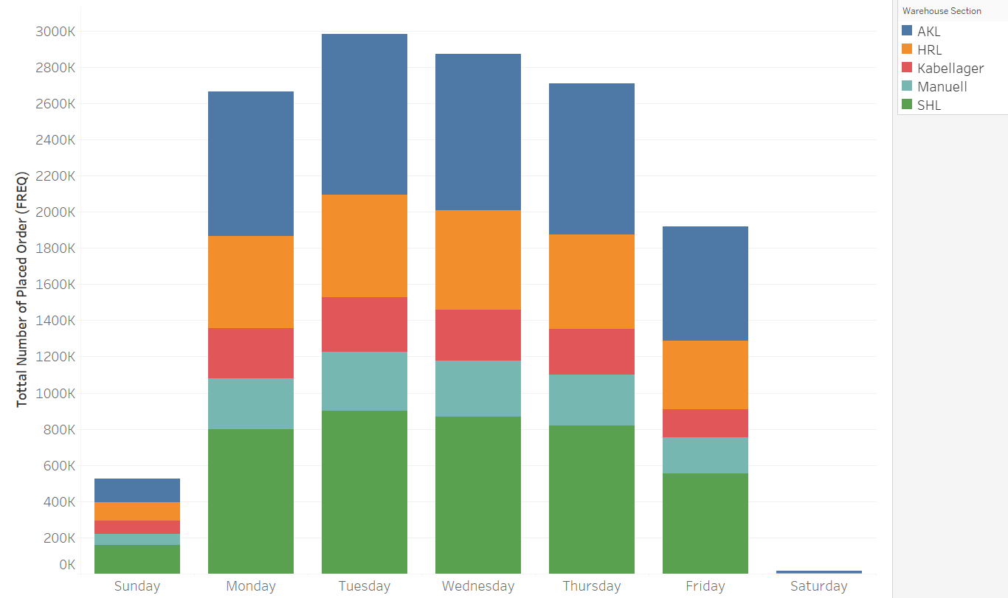
Weekly Order Flow
The busiest day for the warehouse is on Tuesday.
The slowest days are during the weekend.

Slide 20
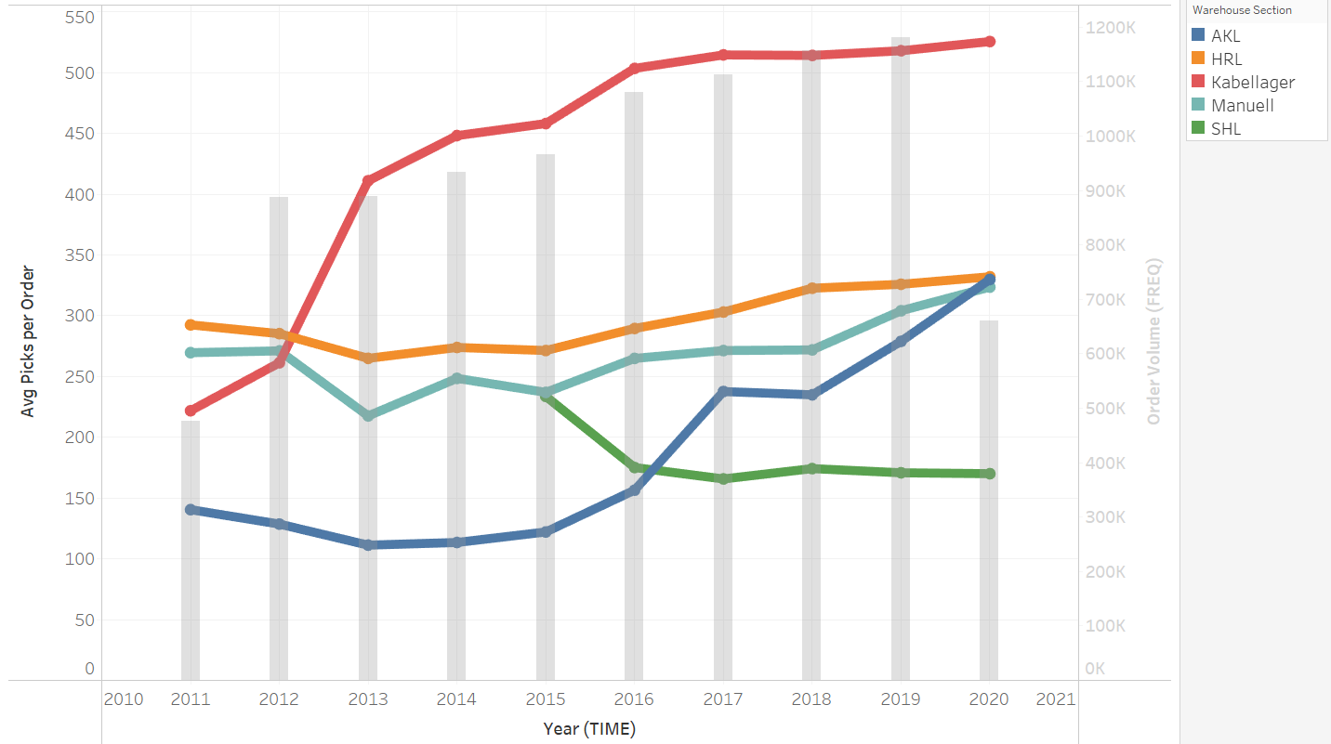
Warehouse Performance
Kabellager has the most picks per order
Pick per order at Kabellager and AKL are increasing, while HRL and Manual are constant.
Picks per order is on a decline for SHL.

Slide 21
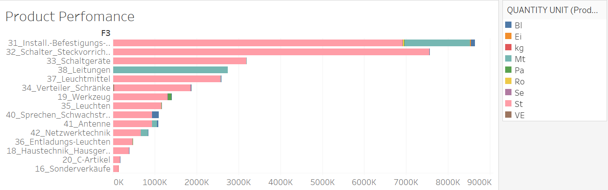
Product Performance
The 31 Product group is the most picked one and the 16 is the least picked one .
We can see different varying quantities based of different quantity units.

Slide 22
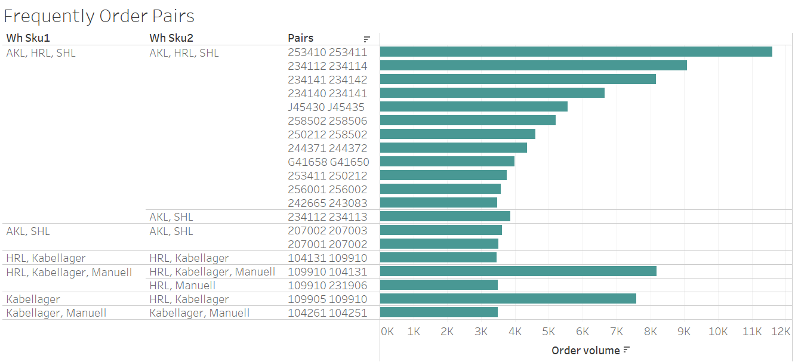
Frequently ordered Products Pairs
3 pairs out of the top 20 SKUs, are not stored in the same warehouses, which could lead to inefficiencies when picking orders

Slide 23
Dashboard

Slide 24
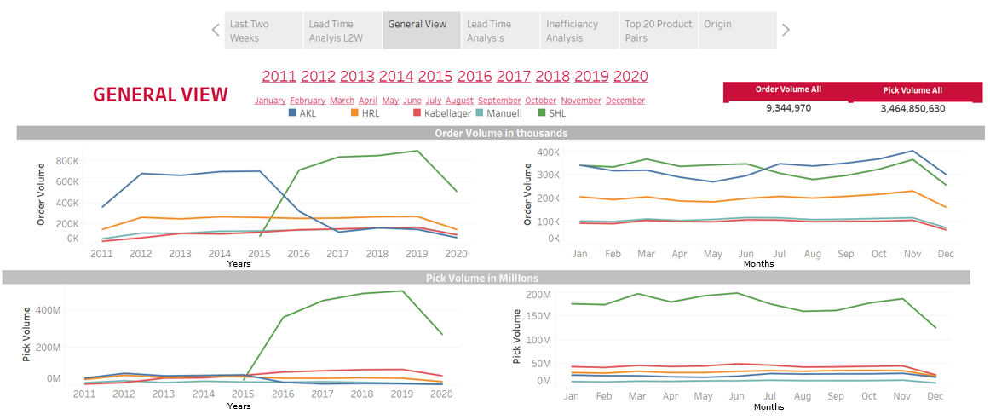
General Overview

Slide 25
Insights and Suggestions
Insights
Suggestions
Orders and picks have consistently increased over the years for all Warehouse Sections.
March and November consistently have the highest order volume, while May and August have the lowest.
Over the years, Kabellager has consistently been the worst-performing warehouse. There was a transition from AKL to SHL in 2015.
Introduce new technology in the warehouses to meet growing demand.
Initiate hiring processes early for peak months and implement promotional offers to boost order volume during low-performing months.

Slide 26
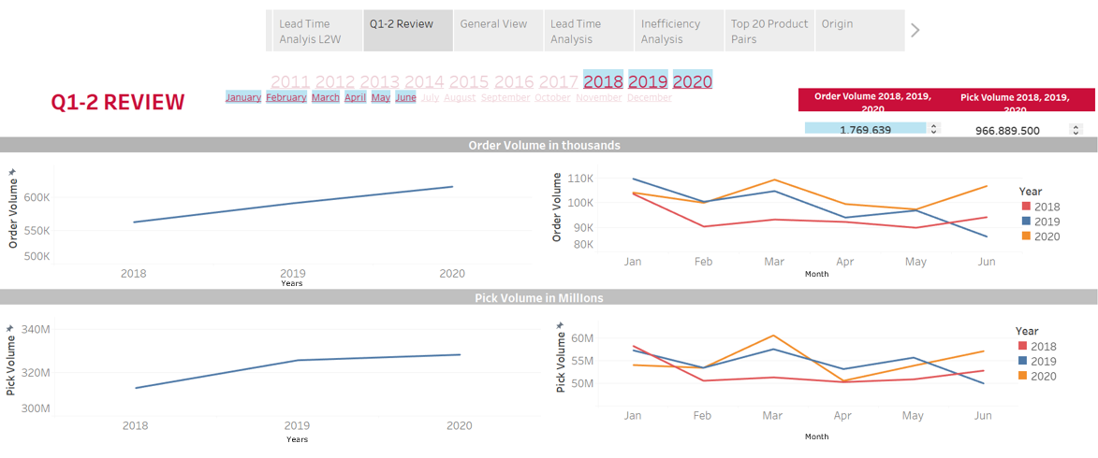
Q1 and Q2

Slide 27
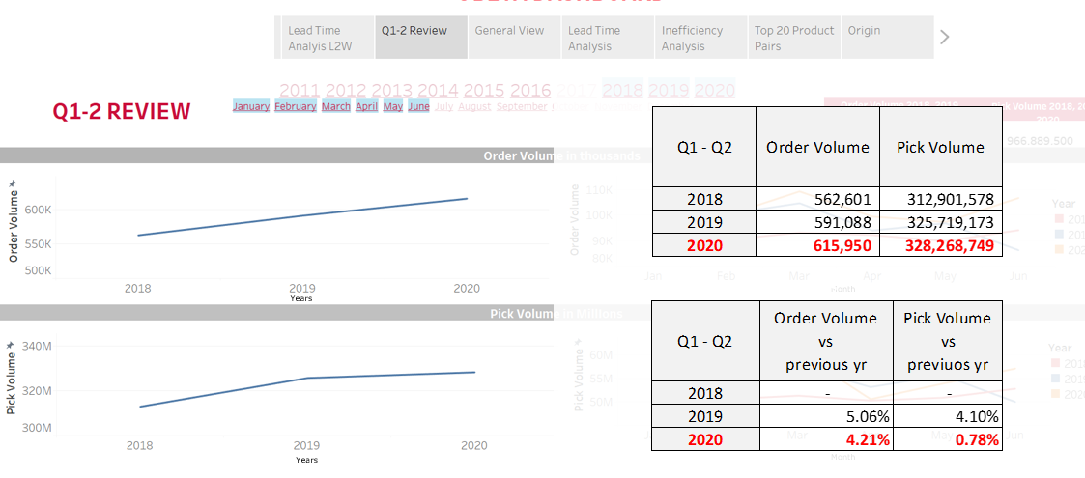

Slide 28
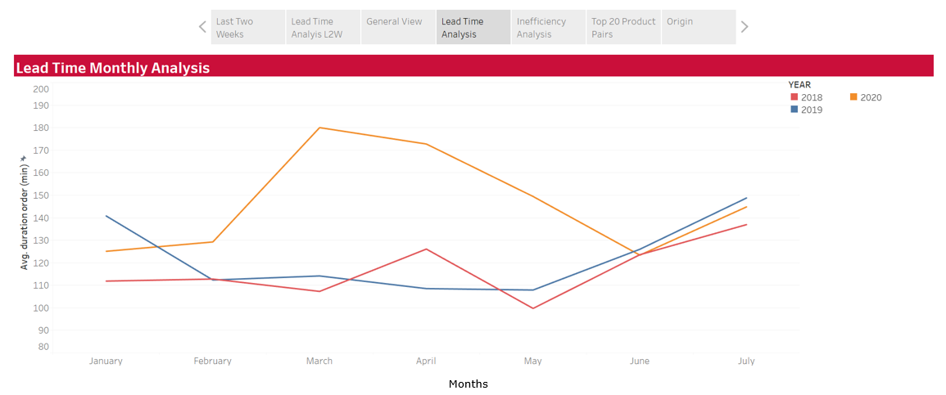
Average Lead-Time

Slide 29
Insights and Suggestions
Insights
Suggestions
Although Q1 & Q2 in 2020 saw a mild rise in order and pick volumes compared to the 2018 and 2019, the performance in 2020 was good.
However, there was a sharp rise in average Lead Time by 1 hour in MAR–APR 2020, which can be due to a variety of reasons.
End of every quarter tends to receive more order and pick volume.
Therefore, like it was handled in June, allocating more workers is crucial for meeting the annual / Q3-4 target.

Slide 30
Conclusion
In this project, I analyzed raw data, conducted ETL processes, and built dashboards. Cleaning involved refining headers, managing outliers, null values, and special characters, while transformation included establishing entity relationships, time series calculations, and calculating KPIs. I established connections between MySQL, Jupyter Notebook, and Tableau facilitating seamless data flow. The dashboard focuses on warehouse performance over years, identifying areas for improvement, particularly in order processing efficiency. While performance has remained steady, there's room for improvement over time, even with the integration of automated warehouses.

Slide 31
Thank You For Your Time And Attention!

